Slide 1
Introduction
Northwind Traders is a fictitious wholesale company that specializes in importing and exporting a wide range of specialty food products from different parts of the world. The company operates through a network of customers, suppliers, employees, and shipping partners to manage its business operations efficiently.
The organization deals with order processing, inventory management, customer relationships, and logistics, making it an ideal case for business data analysis. The dataset used in this project contains detailed transactional data related to orders, products, customers, employees, suppliers, and shippers.
This project aims to utilize Power BI to transform raw data into meaningful insights through interactive dashboards. By analyzing key business areas such as customer behavior, product performance, employee efficiency, and shipping operations, the report helps in identifying trends, patterns, and opportunities.
The insights generated from this dashboard can support data-driven decision-making, improve operational efficiency, and enhance overall business performance. This project demonstrates how visualization tools like Power BI can be used effectively to analyze complex datasets and present them in a simple and understandable format.

Slide 2
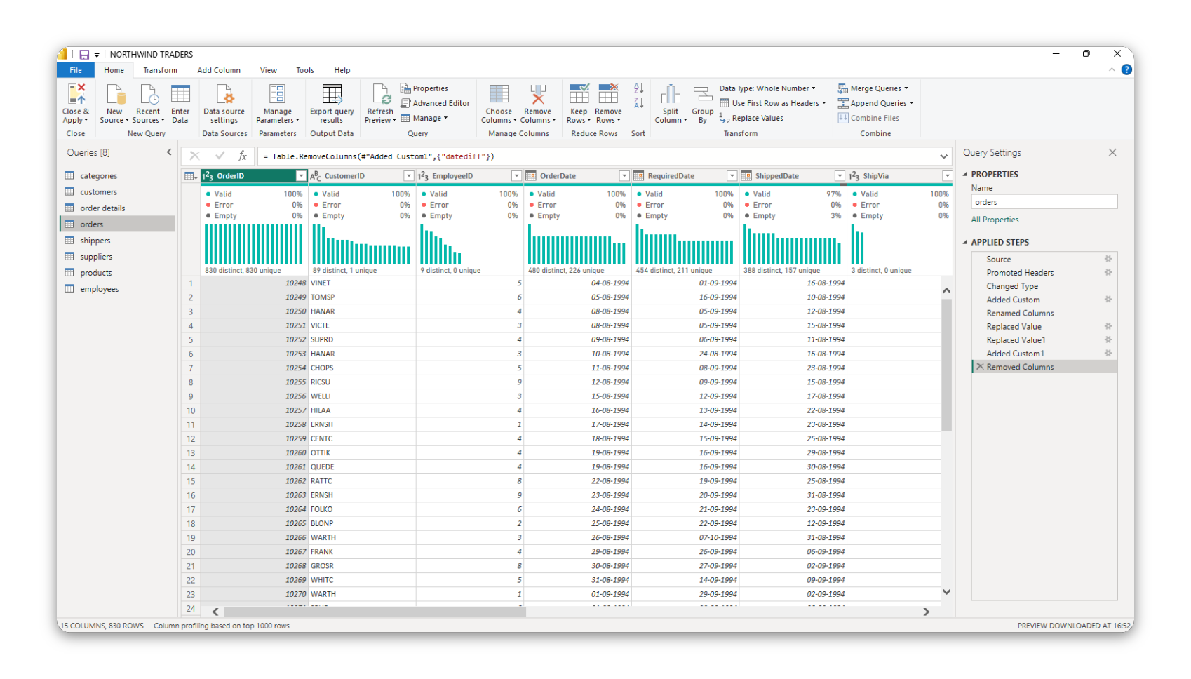
Data Cleaning and Preparation

Slide 3
Data Cleaning and Preparation
Data cleaning was performed using Power Query Editor in Power BI to ensure accuracy and consistency of the dataset.
First, null and missing values were handled by either removing rows with missing data or replacing them with appropriate values such as zero in the case of discounts. This helped in avoiding errors during analysis.
Second, data types of columns were corrected to ensure proper calculations. For example, date columns were converted into date format, while numerical fields such as price and quantity were converted into appropriate numeric formats.
Duplicate records were identified and removed to maintain data integrity and avoid misleading results. Additionally, error values were handled by replacing or removing them.
New calculated columns were created to enhance analysis, such as combining first name and last name to form employee names, and calculating total sales using price and quantity.
Finally, columns were renamed for better readability and understanding. These steps ensured that the dataset was clean, structured, and ready for effective analysis in Power BI.

Slide 4
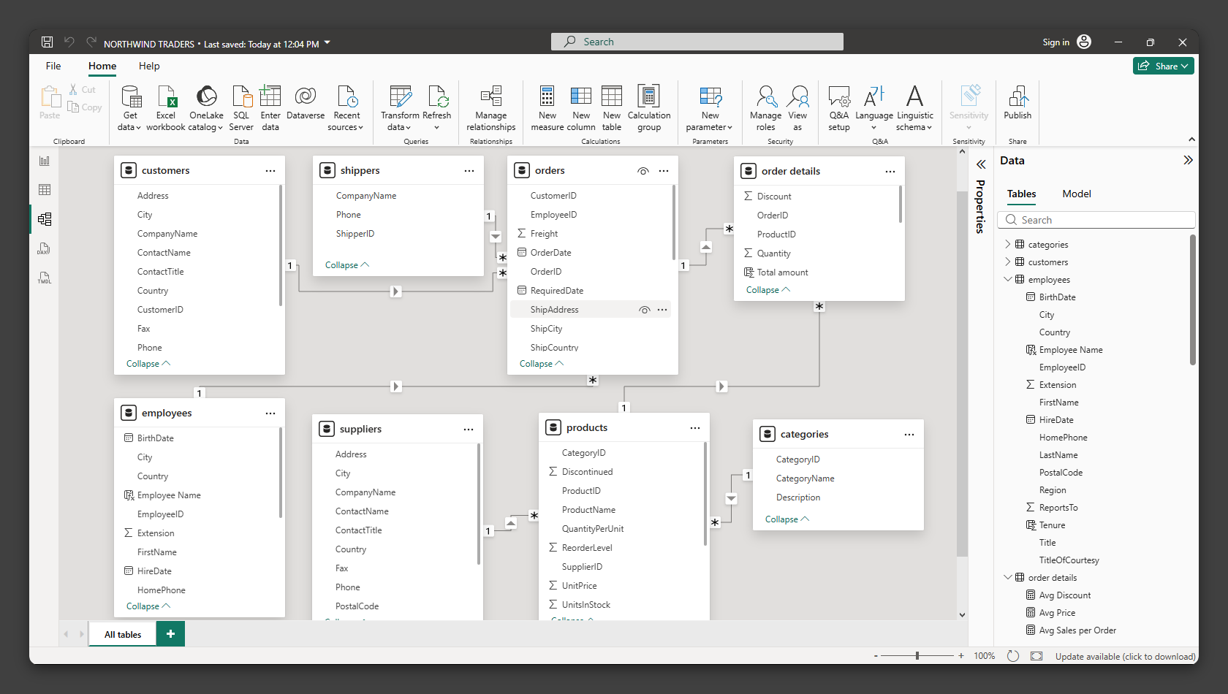
Data model (er diagram)

Slide 5
The data model represents the relationships between different tables in the Northwind dataset. It is designed using a relational structure where multiple tables are connected through primary and foreign keys. The central table in the model is the "Order Details" table, which acts as a fact table containing transactional data such as quantity, unit price, and discount. This table is connected to various dimension tables including Customers, Orders, Products, Employees, Shippers, Suppliers, and Categories. The Customers table is connected to the Orders table through CustomerID, indicating that one customer can place multiple orders. The Orders table is further connected to the Order Details table through OrderID, representing that one order can contain multiple products. The Products table is linked to the Order Details table using ProductID, showing that each product can appear in multiple orders. Additionally, Products are categorized using the Categories table and supplied by the Suppliers table. The Employees table is connected to Orders, indicating that each employee handles multiple orders. Similarly, the Shippers table is connected to Orders to represent the delivery of orders. Overall, the model follows a star schema structure which improves performance and enables efficient data analysis in Power BI.
Data model (er diagram)

Slide 6
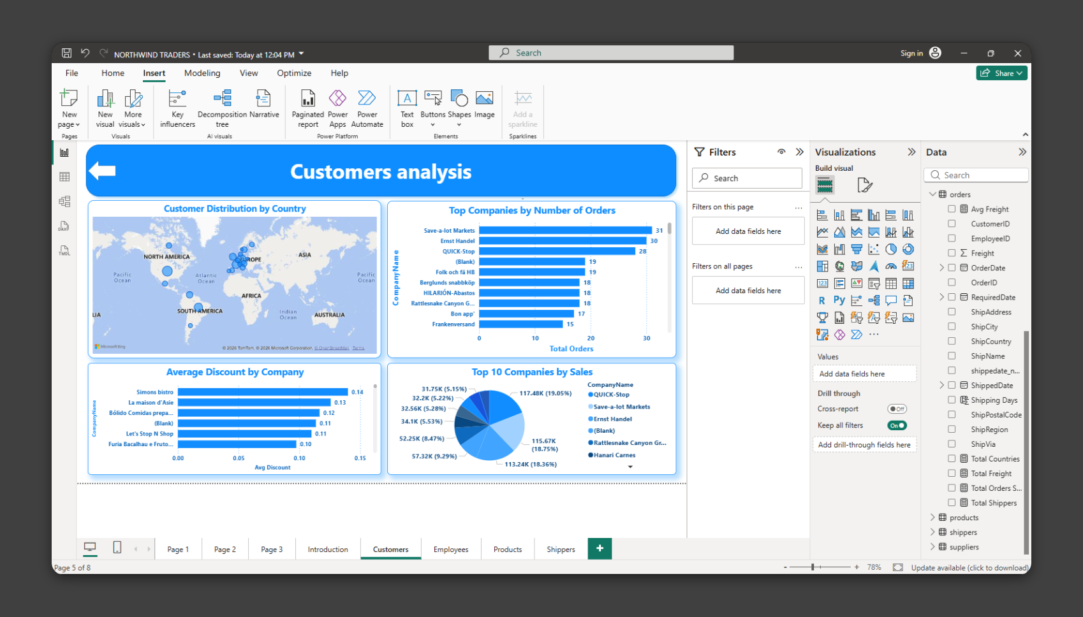
Customer Analysis Dashboard
This dashboard provides insights into customer behavior, purchasing patterns, and revenue contribution.
A map visualization is used to show the geographic distribution of customers across different countries, helping to identify key markets. A bar chart displays the number of orders placed by different companies, highlighting the most active customers.
Additionally, a pie chart represents the top 10 customers based on total sales, showing which customers contribute the highest revenue. Another bar chart shows the average discount provided to customers, helping to understand pricing strategies.
Overall, this dashboard helps in identifying high-value customers, understanding their ordering behavior, and analyzing how discounts impact sales.
Key Insight: A small number of customers contribute a large portion of total revenue, indicating the presence of high-value repeat customers.

Slide 7
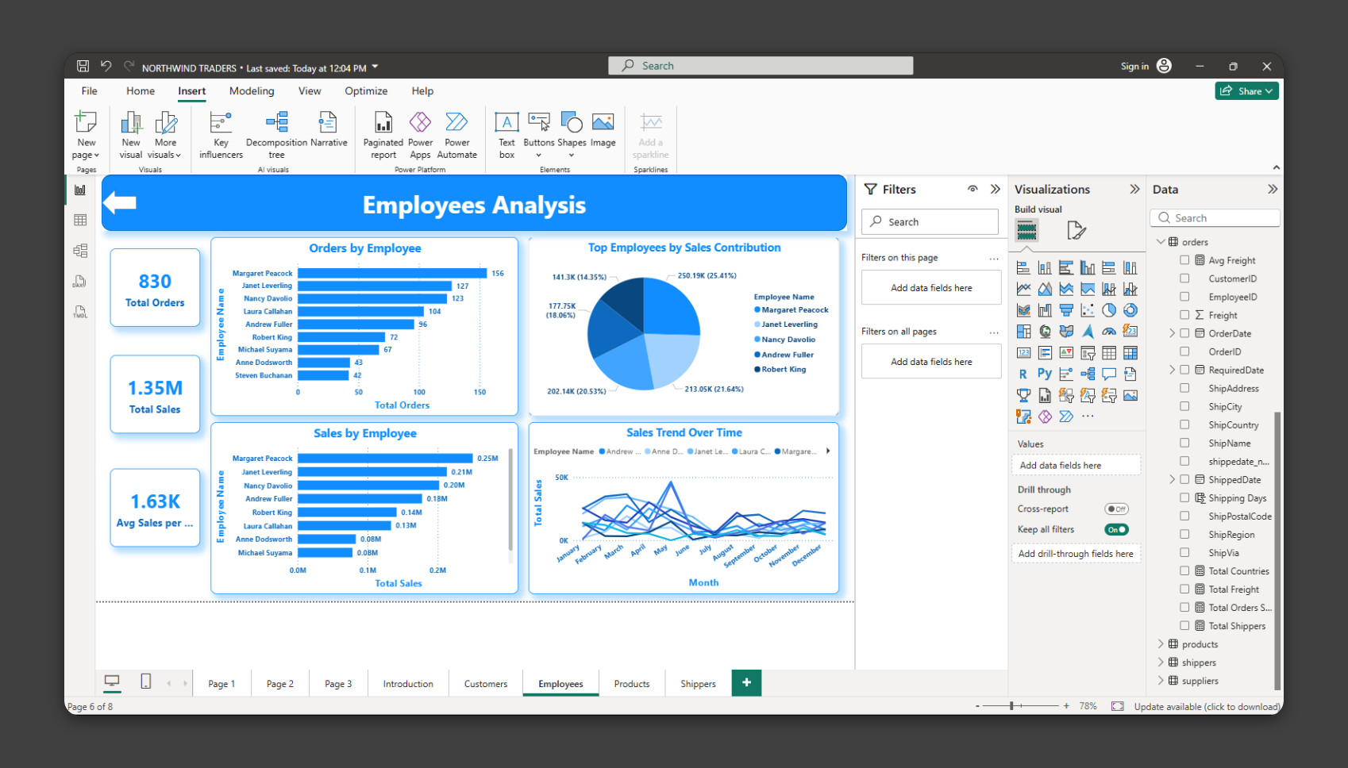
Employee Analysis Dashboard
This dashboard evaluates the performance of employees based on their contribution to orders and sales.
KPI cards are used to display total orders, total sales, and average sales per employee. A bar chart shows the number of orders handled by each employee, helping to identify the most active employees.
Another bar chart highlights total sales generated by each employee, providing insights into revenue contribution. A pie chart shows the distribution of sales among top employees, while a line chart represents the sales trend over time.
This dashboard helps in comparing employee performance and understanding productivity patterns.
Key Insight: Some employees handle more orders and generate higher sales, indicating differences in performance levels.

Slide 8
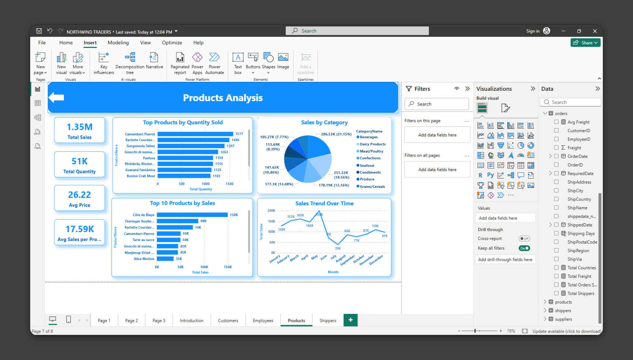
Product Analysis Dashboard
This dashboard focuses on product performance, sales trends, and category contribution.
KPI cards display total sales, total quantity sold, and average price of products. A bar chart shows the top products based on quantity sold, helping to identify the most demanded items.
Another bar chart highlights the top products by total sales, indicating the highest revenue-generating products. A pie chart represents sales distribution across different product categories.
A line chart is used to show sales trends over time, helping to identify seasonal patterns and growth trends.
This dashboard provides insights into which products and categories drive business performance.
Key Insight: A few products and categories contribute significantly to total sales, indicating key revenue drivers.

Slide 9
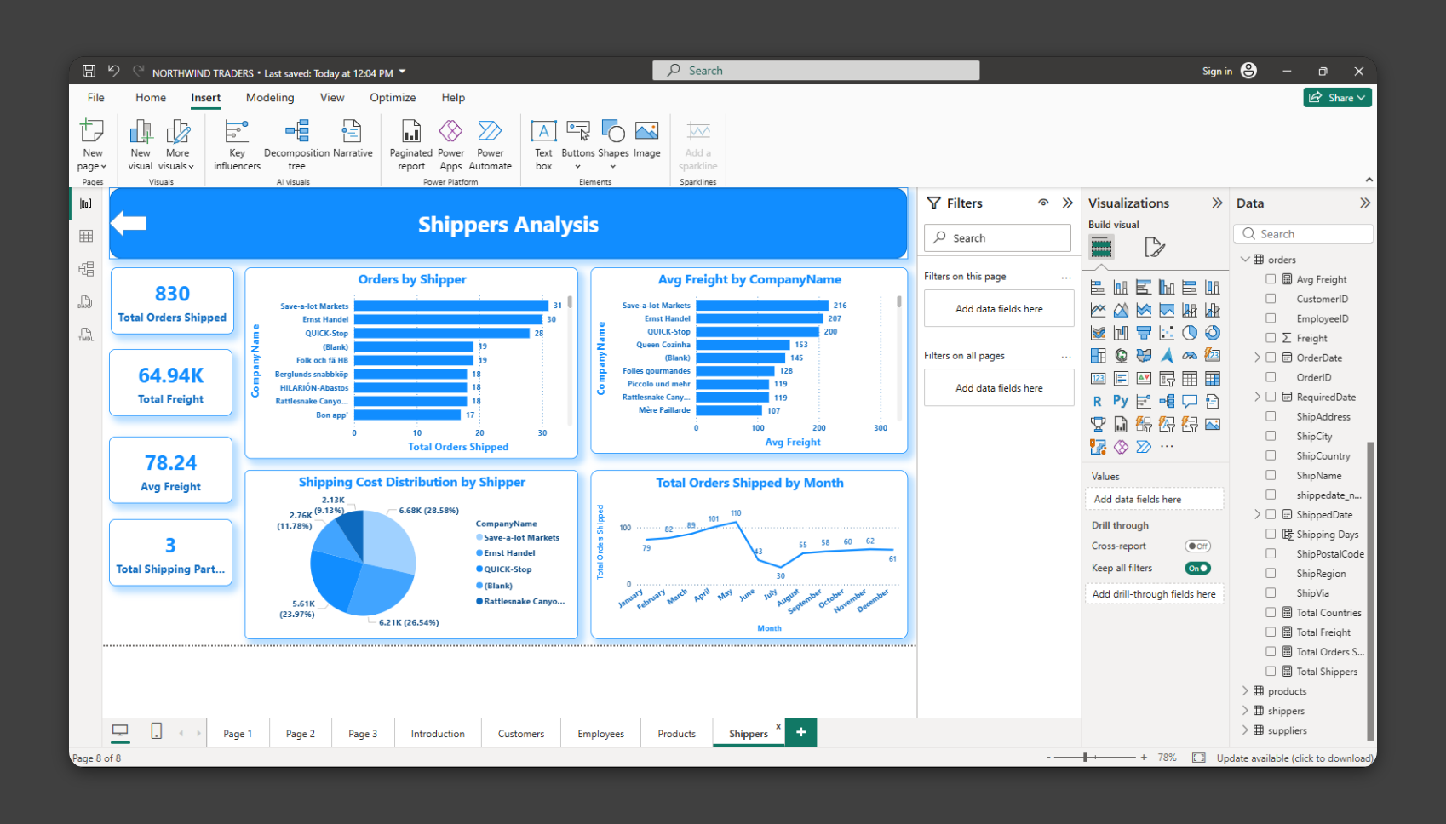
Shipper Analysis Dashboard
This dashboard analyzes shipping performance, cost distribution, and delivery trends.
KPI cards display total orders shipped, total freight cost, average freight cost, and total number of shipping partners. A bar chart shows the number of orders handled by each shipper, identifying the most frequently used shipping companies.
Another bar chart compares average freight cost across shippers, helping to identify expensive and cost-effective shipping partners. A pie chart shows the distribution of shipping costs among different shippers.
A line chart represents the monthly trend of shipped orders, providing insights into shipping activity over time.
This dashboard helps in evaluating shipping efficiency and cost management.
Key Insight: Some shippers handle more orders but may also have higher costs, indicating a trade-off between usage and cost.

Slide 10
Summary of Analysis
The Power BI dashboard successfully provides a comprehensive view of Northwind Traders' business performance by integrating data from multiple tables.
The analysis highlights customer behavior, employee performance, product demand, and shipping efficiency. It was observed that a small number of customers and products contribute significantly to overall revenue, indicating the importance of key business drivers.
Employee analysis revealed differences in performance, where some employees handle more orders and generate higher sales. Product analysis showed that certain categories and products dominate sales, while shipping analysis highlighted variations in cost and usage among different shippers.
Overall, the dashboard enables better understanding of business operations and supports data-driven decision-making through interactive and visual insights.

